Slide 1
CPU Scheduling
Alim Ul Karim
alim.karim.nsu@gmail.com

Slide 2
Windows CPU Scheduling
Windows XP --- Windows 7 and 8

Slide 3

“Education is what
remains after one
has forgotten what
one has learned in school.”
- Albert Einstein
http://bit.ly/USlvnx

Slide 4
What’s CPU Scheduling?
In simple words what runs next.

Slide 5
Will not be exactly correct

Slide 6
We have seen algorithms in books
}
Fast Come Fast Serve
Shortest Job First
Preemptive
Non-preemptive
Round Robin
Priority Scheduling
Multilevel Queue Scheduling
Multilevel Feedback Queue Scheduling
Time Sharing Concept

Slide 7
Windows CPU Scheduling
Fast Come Fast Serve
Shortest Job First
Preemptive
Non-preemptive
Round Robin (http://bit.ly/USl6Sd)
Priority Scheduling
Multilevel Queue Scheduling
Multilevel Feedback Queue Scheduling (http://bit.ly/USl6Sd)

Slide 8
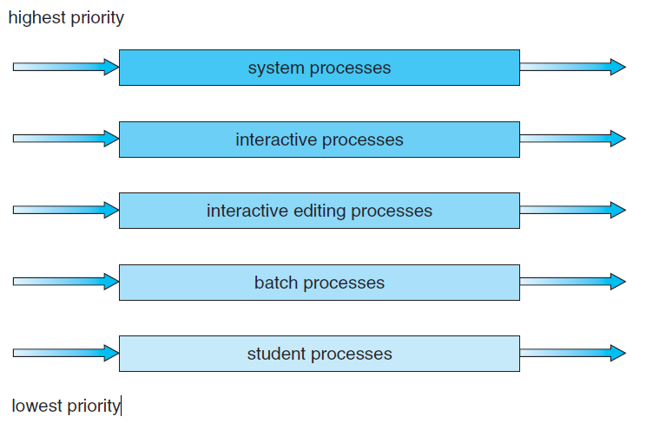
Multilevel Queue Scheduling

Slide 9
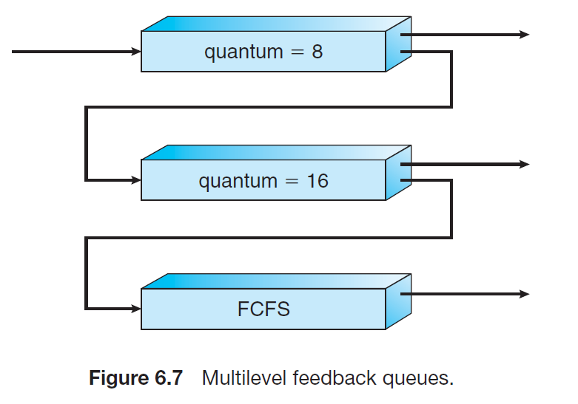
Multilevel Feedback Queue Scheduling

Slide 10
Taskbar Processes are Foreground

Slide 11
But it’s not.

Slide 12
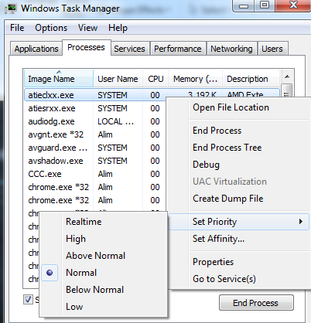
Windows Priority and Scheduling
The scheduler is called a dispatcher
There are 32 priority levels
User class: priorities 1 to 15
Real-time class: priorities 16 to 31
Priority “0” is used for memory
management processes
There is a queue for each priority.

Slide 13
Higher priorities has less number.

Slide 14
Windows Priority and Scheduling
Task | Priority | State
Task1 | Real-time | Waiting
Task2 | Real-time | Ready
Task3 | High | Read
… | .. | ..
… | .. | ..
.. | .. | .
. | .. | .
Dispatcher

Slide 15
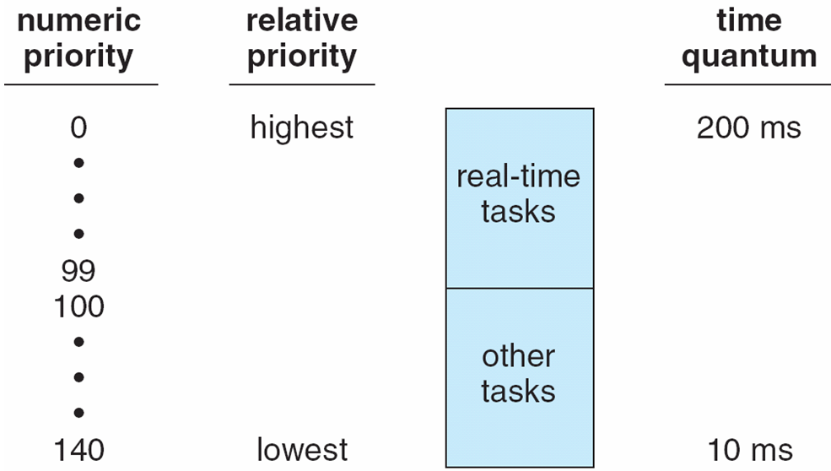
Linux: Priorities and Time-slice length
http://bit.ly/USots7

Slide 16
Thank you.
Alim Ul Karim
alim.karim.nsu@gmail.com

Slide 17
Questions??

